Slide 1

CHAPTER 10 Capacity Planning
|Cloud Computing

Slide 2
Introduction
What is Capacity Planning?
It is a strategy to ensure that resources are sufficient to meet demand while minimizing costs.
Goals:
Meet current and future service demands.
Avoid resource wastage and underutilization.
Critical for maintaining system performance and controlling costs.

Slide 3
The Illusion of Infinite Resources
Cloud services create the impression of unlimited resources through:
Resource virtualization.
Auto-scaling mechanisms.
However, physical limitations exist at the data center level.
Proper capacity planning prevents resource shortages and unexpected costs.
Capacity Planning Across Cloud Service Layers

Slide 4
Capacity Planning Across Cloud Service Layers: Responsibility Distribution
IaaS Providers:
Handle physical resource planning.
Monitor consumer requirements via Service Level Agreements (SLAs).
PaaS Providers:
Manage virtual resources or rely on IaaS providers.
SaaS Providers:
Plan capacity based on consumer needs and SLAs.
Consumer Roles in Capacity Planning
Consumers must estimate and communicate resource needs to service providers.
Inaccurate estimations may result in higher costs due to dynamic billing models.

Slide 5
Multi-Layer Capacity Planning
Company A (IaaS Provider): Provides physical infrastructure.
Company B (PaaS Provider): Builds platforms on IaaS resources & Plans additional virtual servers to handle spikes.
Company C (SaaS Provider): Offers applications to end-users and relies on PaaS for capacity.
End Users: Estimate needs or pass responsibility to the SaaS provider.

Slide 6
Strategies for Effective Capacity Planning
Data Collection: Analyze consumer behavior and application usage patterns.
Dynamic Resource Management: Use auto-scaling to meet fluctuating demands.
Collaboration: Ensure communication across layers (SaaS, PaaS, IaaS).
SLAs: Define responsibilities and capacity requirements clearly.

Slide 7
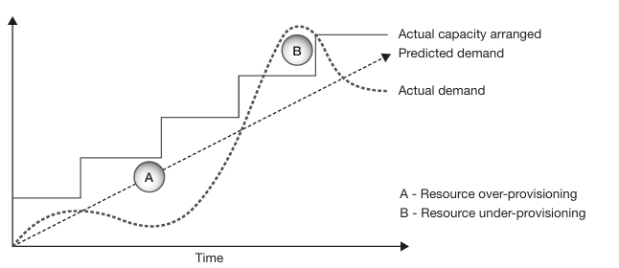
Capacity Planning: Then and Now
Traditional Fixed Cost Computing Model:
Fixed Investment: Organizations allocated resources for several years based on average demand estimations, leading to two main issues:
Over-Provisioning (A): Excess resources during low demand resulted in wastage of capacity and investment.
Under-Provisioning (B): Insufficient resources during peak demand led to degraded performance and lost revenue opportunities.
Resource Wastage: Idle resources in low-demand periods increased costs.

Slide 8
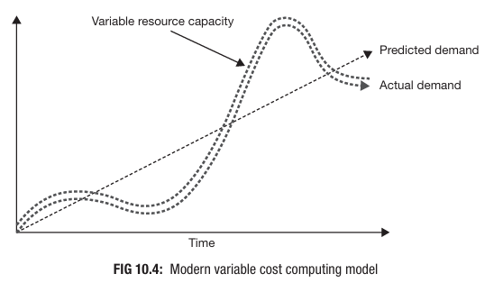
Capacity Planning: Then and Now
Modern Variable Cost Computing Model:
Pay-Per-Use: Cloud computing allows dynamic resource provisioning where organizations rent resources as needed.
Dynamic Scaling: Resources align closely with demand, reducing waste and ensuring performance during spikes.
Efficiency Gains: Multi-tenancy in cloud environments allows providers to balance resource allocation across clients, improving overall utilization.

Slide 9
Approaches to Maintaining Sufficient Capacity
Traditional Approach with N+1 Rule
Redundancy: Organizations provision N+1 nodes (one extra) to handle unexpected spikes or node failures.
Limitations: Static in nature and can still result in over-provisioning or delays during unexpected surges.
Cloud-Specific Approach
Auto-Scaling: Automatically adjusts resources to meet demand, reducing the burden on capacity planners.
Flexibility: Cloud providers manage infrastructure using virtual resources, which scale based on usage patterns.

Slide 10
Capacity vs. Performance
Capacity Planning: Focuses on ensuring future resource availability to handle workloads effectively.
Performance Optimization: Aims to maximize output with existing resources, enhancing system efficiency.

